Slide 1

Models of Failure and Phase Transitions in Strong Ceramics under Intense Shock Loading
VNIIA
ROSATOM
The 4th International Conference on Material Strength and Applied Mechanics (MSAM 2021)
Dr. Sergey Dyachkov, Dr. Sergey Grigoryev
Dukhov Research Institute of Automatics (VNIIA)
Moscow, Russia

Slide 2
Outline
VNIIA
ROSATOM
Motivation
development of robust and accurate model of ceramic materials response to shock compression in predictive CFD simulations
Plate impact tests description
Ceramics failure model formulation
Obtaining best model parameters
Simulation results

Slide 3
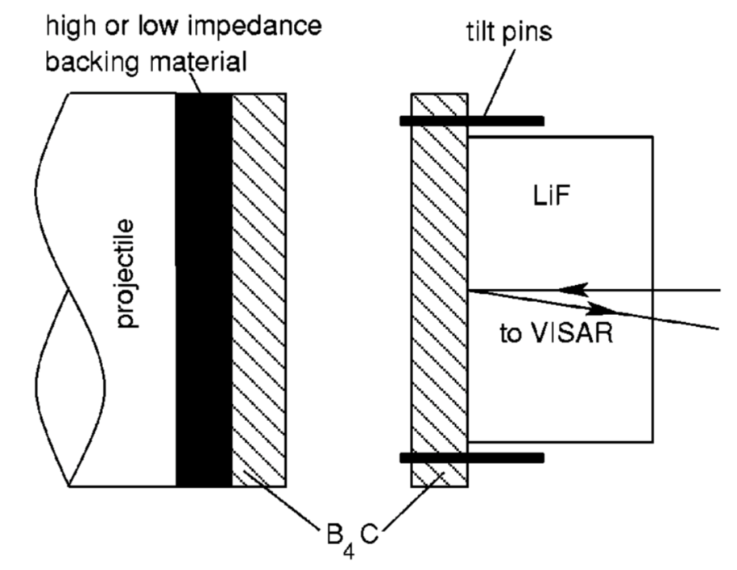
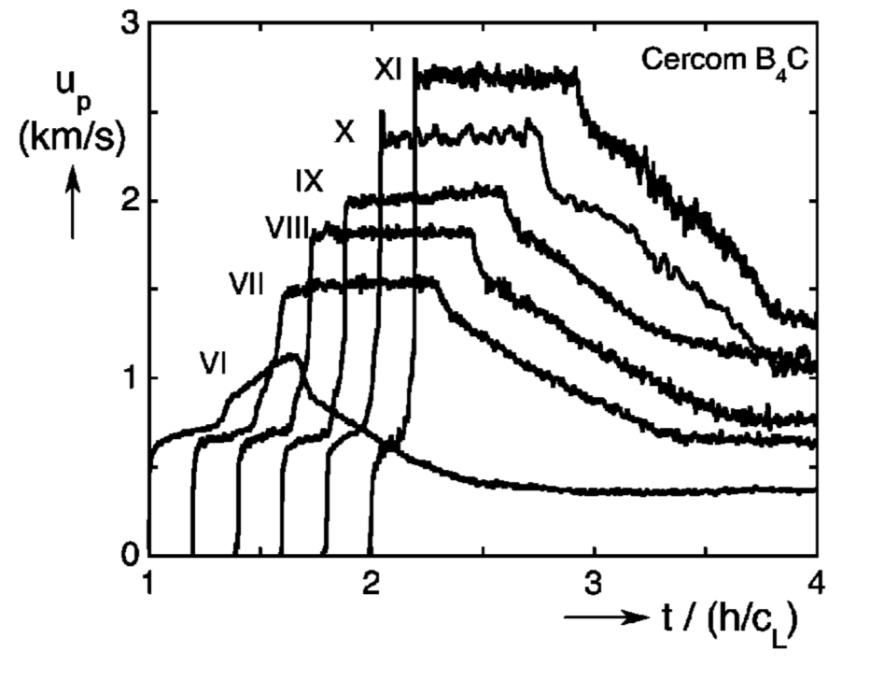
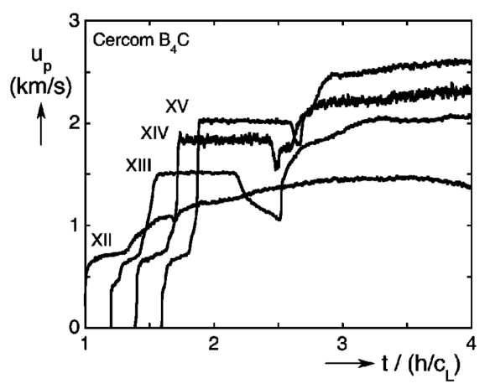
Uniaxial shock compression tests
VNIIA
ROSATOM
Experiment setup*
Measured wave profiles (VISAR)
Impactor and target are of ceramics under study.
Some tests include light or heavy backer material. Target is followed by a transparent LiF window.
Velocity of the ceramics/LiF interface is measured via the velocity interferometer (VISAR).
*T. J. Vogler, W. D. Reinhart, L. C. Chhabildas, Journal of Applied Physics 95, 4173 (2004)

Slide 4
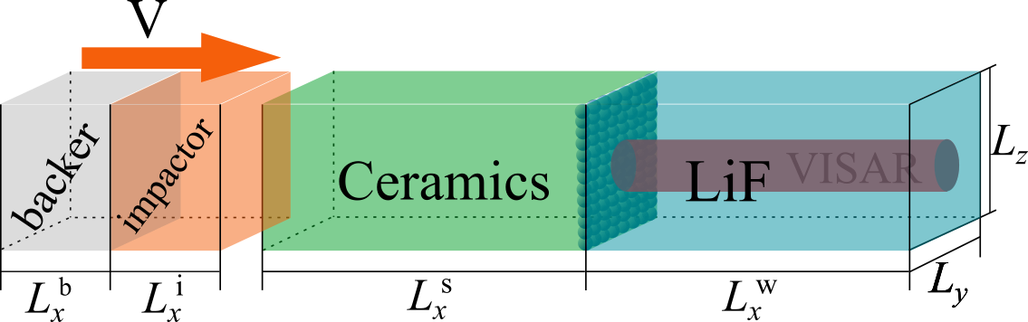
Simulation setup and reference data
VNIIA
ROSATOM
Simulation methods
1D finite element method (FEM) for model parameters fitting
3D smoothed particle hydrodynamics (SPH) method for validation
Experiments
Boron carbide (B₄C): no structural phase transitions, localized amorphization as a result of material failure (strength degradation)
Silicon carbide (SiC), aluminum nitride (AlN): phase transitions (structural changes in the material bulk) accompanied by strength degradation
D. E. Grady and R. L. Moody, Tech. Rep. SAND96-0551 (Sandia National Laboratories, 1996)
T. Vogler, W. Reinhart, L. Chhabildas, J. Appl. Phys. 95 4173 (2004)
T. Vogler, W. Reinhart, L. Chhabildas, and D. Dandekar, J. Appl. Phys. 99 023512 (2006)

Slide 5
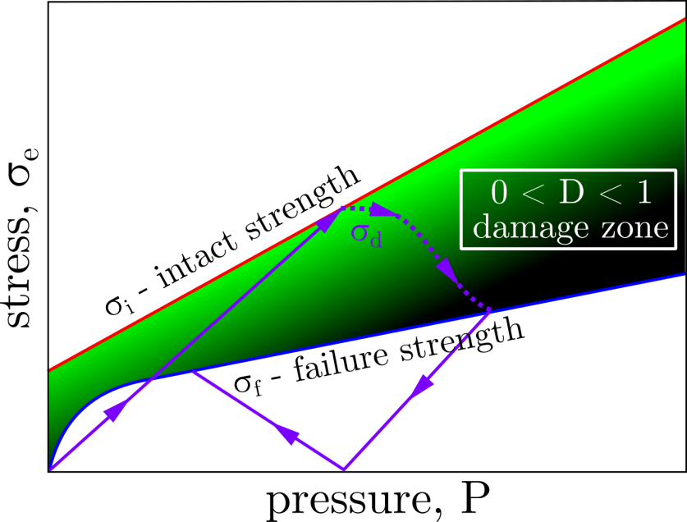
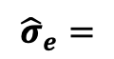
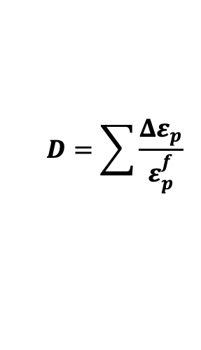
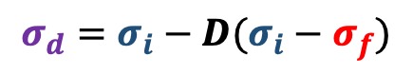
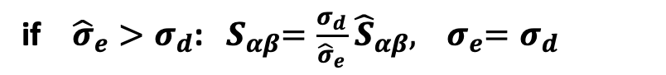
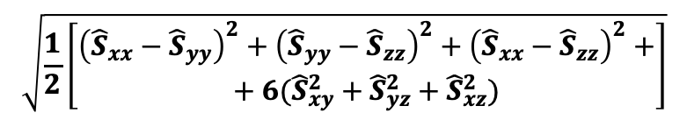
Failure: abrupt change of strength
VNIIA
ROSATOM
Johnson-Holmquist (JH-2) model* with damage kinetics
Limiting shear strength:
$$σ_{d}=σ_{i}−D(σ_{i}−σ_{f})$$
Damage accumulation:
Plastic strain
increment
$$D=\sum{\frac{Δε_{p}}{ε_{p}^{f}}}$$
Plastic strain
of completely
failed material
Deviatoric stress
adjustment:
von Mises yield
criterion
$$\sqrt{\frac{1}{2}\left[\begin{aligned}{\left({\hat{S}}_{xx}−{\hat{S}}_{yy}\right)}^{2}+{\left({\hat{S}}_{yy}−{\hat{S}}_{zz}\right)}^{2}+{\left({\hat{S}}_{xx}−{\hat{S}}_{zz}\right)}^{2}+ \\ + 6({\hat{S}}_{xy}^{2}+{\hat{S}}_{yz}^{2}+{\hat{S}}_{xz}^{2})\end{aligned}\right]}$$
$${\hat{σ}}_{e}=$$
if ${\hat{σ}}_{e}>σ_{d}$: ${ S}_{αβ}=\frac{σ_{d}}{{\hat{σ}}_{e}}$ ${\hat{S}}_{αβ},$ ${ σ}_{e}=σ_{d}$
*G. R. Johnson, T. J. Holmquist, Journal of Applied Physics 85, 8060 (1999)

Slide 6
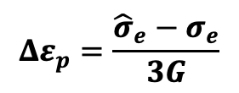
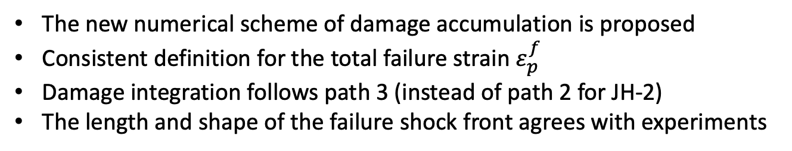
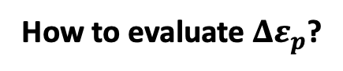
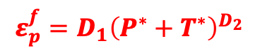
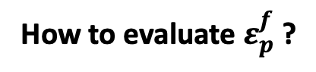
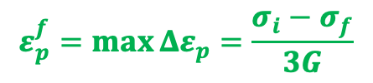
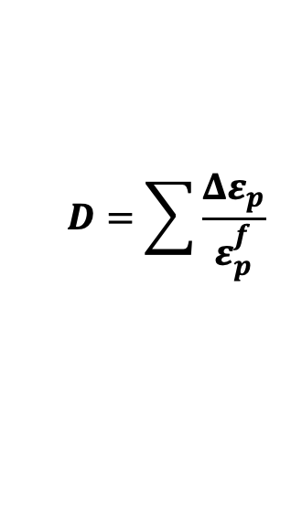
Explicit numerical algorithm
VNIIA
ROSATOM
How to evaluate $Δε_{p}$?
before adjusting
after
adjusting
$$Δε_{p}=\frac{{\hat{σ}}_{e}−σ_{e}}{3G}$$
Wilkins:
shear modulus
How to evaluate $ε_{p}^{f}$ ?
JH - approximation:
$$ε_{p}^{f}=D_{1}{\left(P^{∗}+T^{∗}\right)}^{D_{2}}$$
$$D=\sum{\frac{Δε_{p}}{ε_{p}^{f}}}$$
Consistent approach:
$$ε_{p}^{f}=\max{Δε_{p}}=\frac{σ_{i}−σ_{f}}{3G}$$
The new numerical scheme of damage accumulation is proposed
Consistent definition for the total failure strain $ε_{p}^{f}$
Damage integration follows path 3 (instead of path 2 for JH-2)
The length and shape of the failure shock front agrees with experiments
S. A. Dyachkov et al., Journal of Applied Physics 124 085902 (2018)

Slide 7
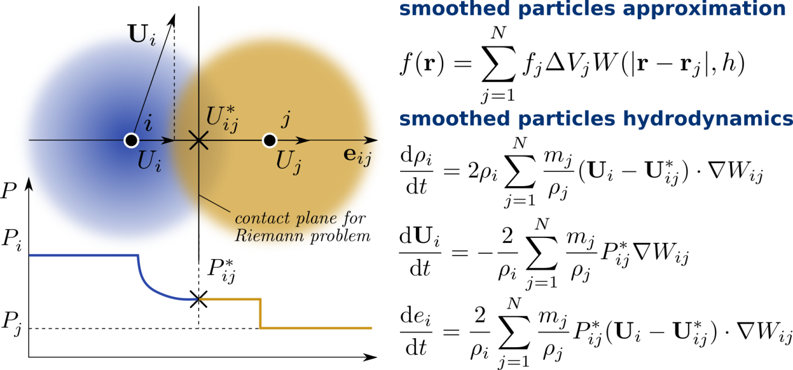
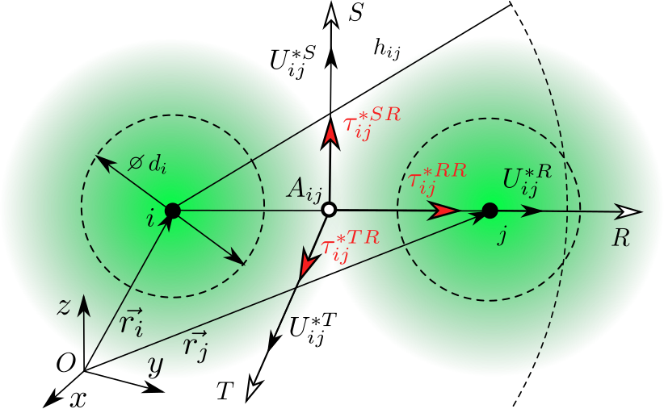

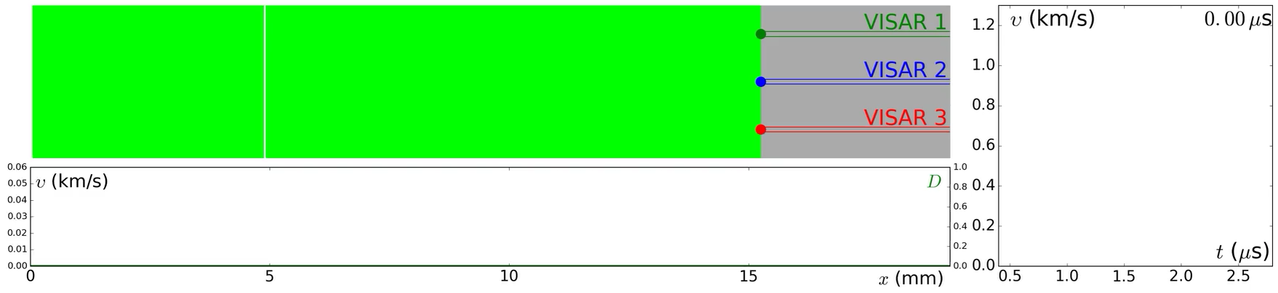
SPH simulation with high resolution
VNIIA
ROSATOM
Function approximation with smoothing kernel
Riemann problem solution with strength
SPH: approximation of Navier-Stokes equations
A. N. Parshikov, S. A. Medin. J. Comp. Phys. 180 353-382 (2002)
Simulation of uniaxial compression of boron carbide
impactor B₄C
target B₄C
window LiF
Experiment BC5: D. E. Grady and R. L. Moody, Tech.Rep. SAND96-0551 (1996)
Simulation: S. A. Dyachkov et al., Journal of Applied Physics 124 085902 (2018)

Slide 8
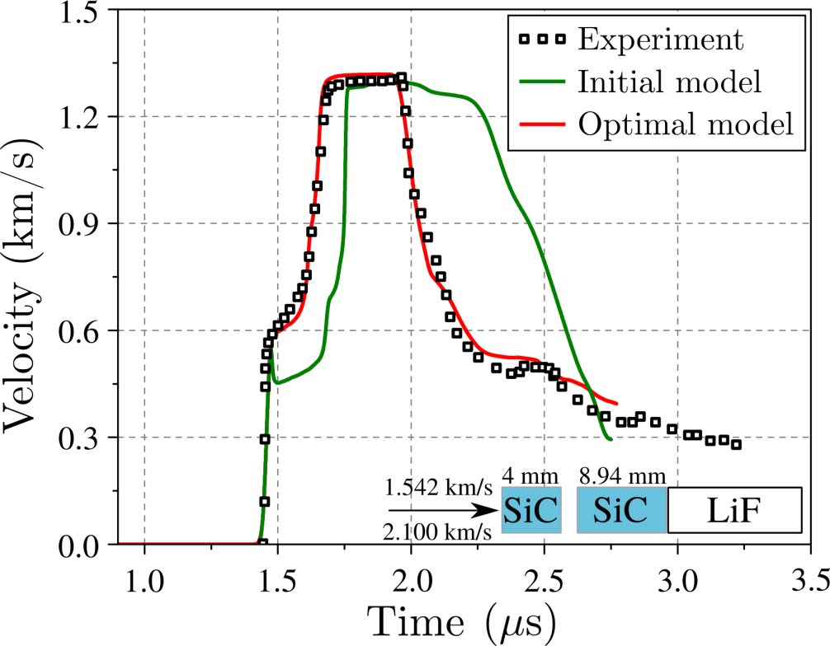
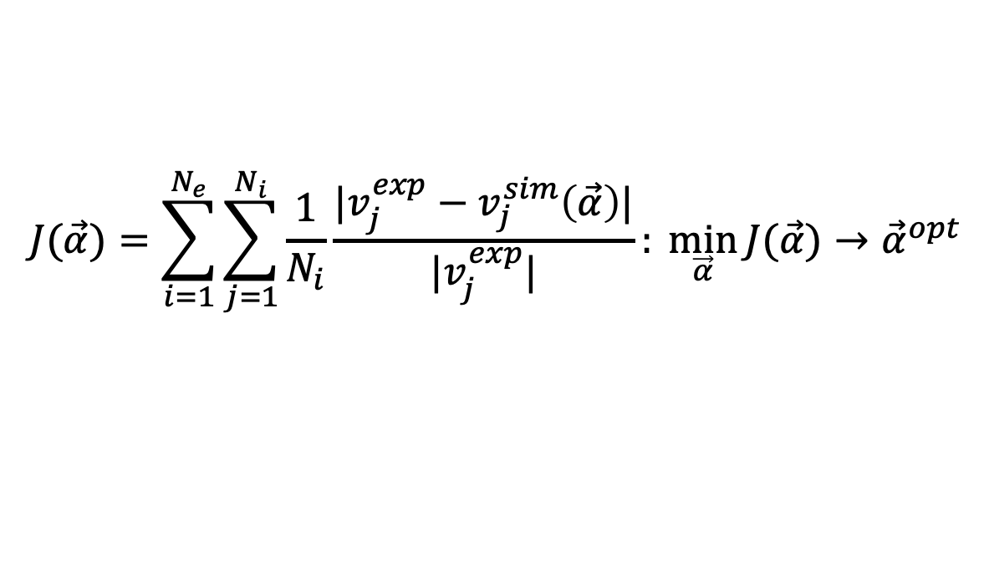
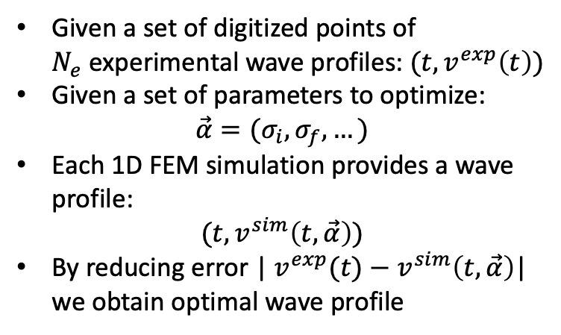
Model parameters fitting
VNIIA
ROSATOM
Given a set of digitized points of $N_{e}$experimental wave profiles:$(t, v^{exp}\left(t\right))$
Given a set of parameters to optimize:
$$\vec{α}=(σ_{i},σ_{f},…)$$
Each 1D FEM simulation provides a wave profile:
$$(t, v^{sim}\left(t,\vec{α}\right))$$
By reducing error | $v^{exp}(t)−v^{sim}\left(t, \vec{α}\right)$| we obtain optimal wave profile
Objective function minimization
$$J(\vec{α})=\sum_{i=1}^{N_{e}}{\sum_{j=1}^{N_{i}}{\frac{1}{N_{i}}\frac{|v_{j}^{exp}−v_{j}^{sim}\left(\vec{α}\right)|}{|v_{j}^{exp}|}: \min_{\vec{α}}{J(\vec{α})}→{\vec{α}}^{opt}}}$$

Slide 9
Boron Carbide

Slide 10
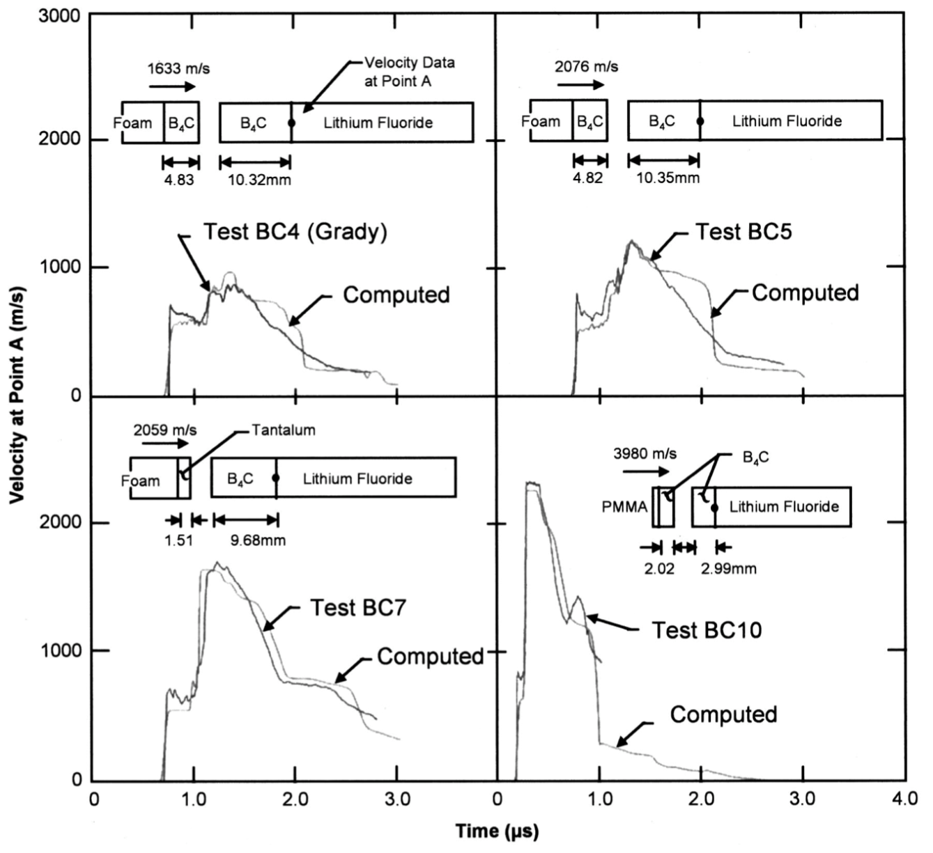
JH simulation* of Grady et al. tests**
VNIIA
ROSATOM
*G. R. Johnson, T. J. Holmquist, Journal of Applied Physics 85, 8060 (1999)
**D. E. Grady and R. L. Moody, Tech. Report SAND96-0551 (1996)

Slide 11
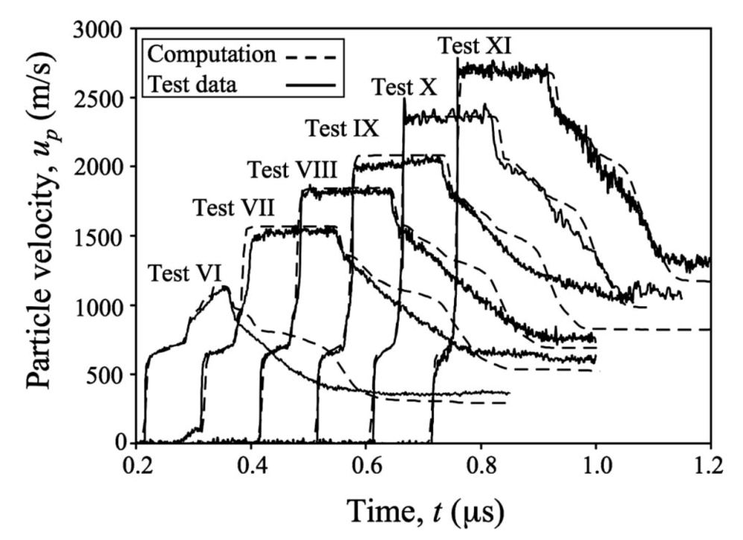
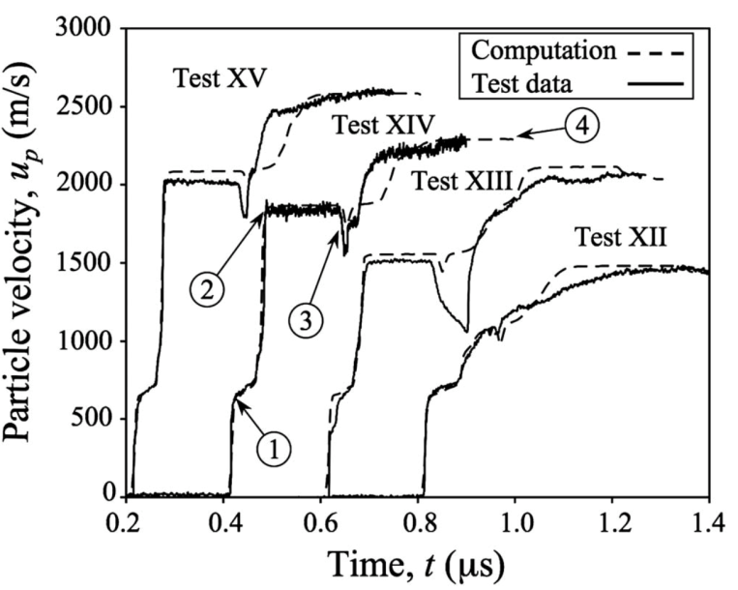
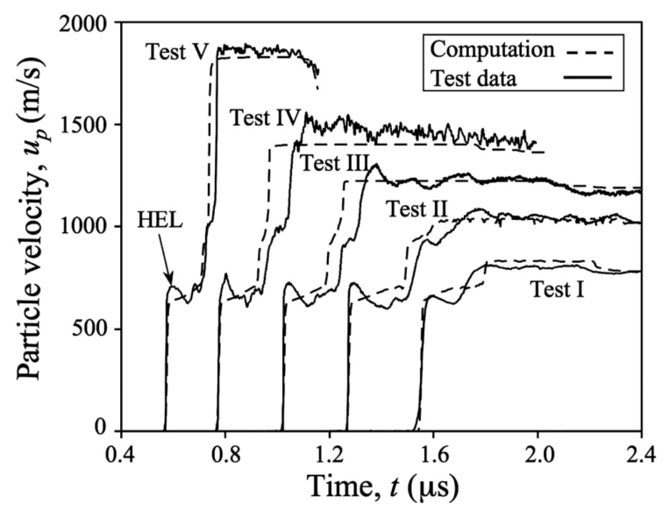
JH simulation* of Vogler et al. tests**
VNIIA
ROSATOM
Johnson-Holmquist-Beissel (JHB) model with kinetics and phase transitions
Problems:
JHB for B₄C contains 26 parameters
Structural phase transition in a region between 30-40 GPa is questionable
Numerical algorithm has lack of details
*T. J. Holmquist, G. R. Johnson, Journal of Applied Physics 100, 093525 (2006)
**T. J. Vogler, W. D. Reinhart, L. C. Chhabildas, Journal of Applied Physics 95, 4173 (2004)

Slide 12
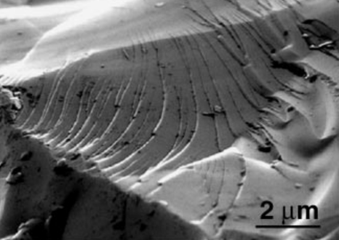
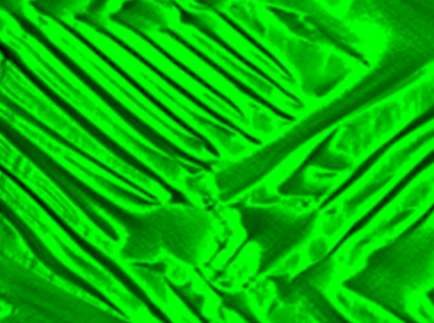
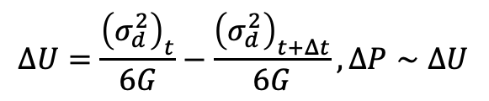
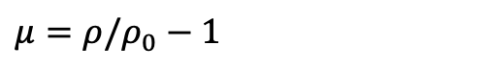
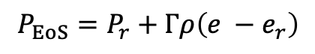
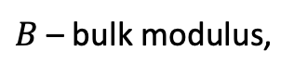
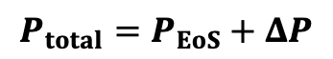
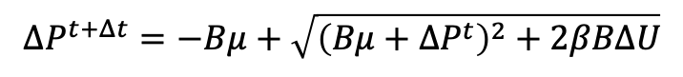
Updating B₄C equation of state*
VNIIA
ROSATOM
Mie-Grüneisen approximation
$$P_{EoS}=P_{r}+Γρ\left(e −e_{r}\right)$$
Local material “bulking” as a result of shear stress induced amorphization:
$B$ – bulk modulus,
$μ=ρ/ρ_{0}−1$
$$ΔP^{t+Δt}=−Bμ+\sqrt{{\left(Bμ+ΔP^{t}\right)}^{2}+2βBΔU}$$
Elastic energy loss during failure process
produces pressure surplus:
B₄C amorphization under shock compression
$$ΔU=\frac{{\left(σ_{d}^{2}\right)}_{t}}{6G}−\frac{{\left(σ_{d}^{2}\right)}_{t+Δt}}{6G}, ΔP∼ΔU$$
Total pressure:
$$P_{total}=P_{EoS}+ΔP$$
Mingwei Chen et al.
Science 299, 1563 (2003)
Localized shear bands in simulations
*P. Dera et al., Journal of Solid State Chemistry 215 85-93 (2014)

Slide 13
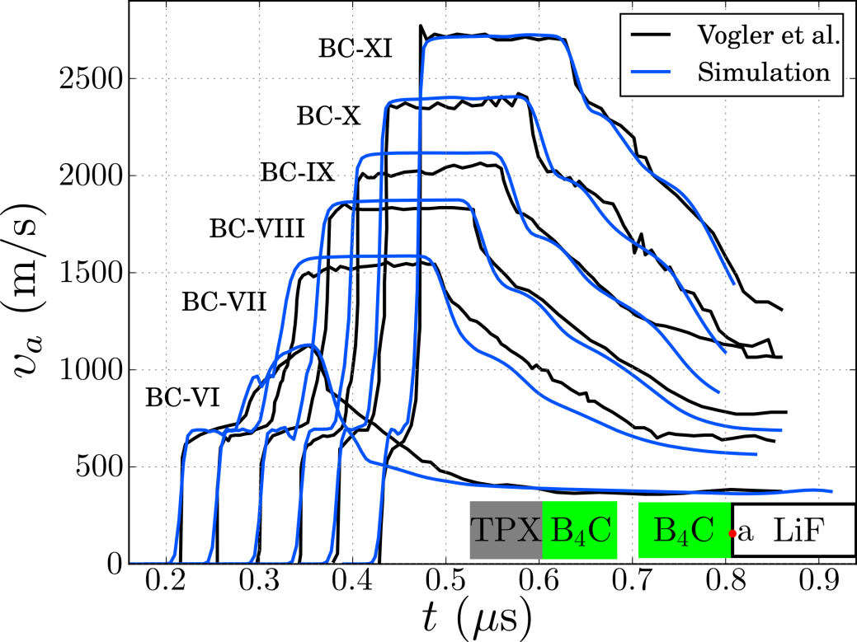
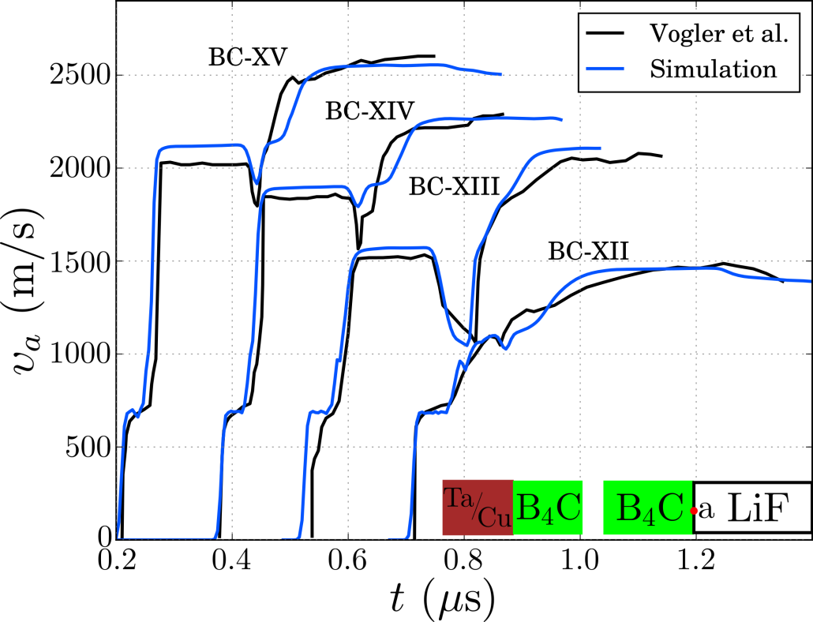
Simulation of Vogler et al. tests*
VNIIA
ROSATOM
Release experiments
Reshock experiments
All tests are simulated using a unique set of model parameters
Simulations agree with experiments in wide range of loading regimes
*Vogler T. et al. J. Appl. Phys. 95, 8, 4173–4183 (2004)
Model: S. A. Dyachkov et al., Journal of Applied Physics 124 085902 (2018)

Slide 14
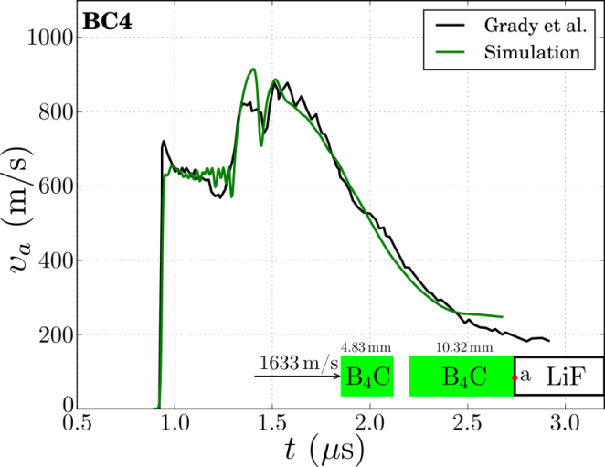
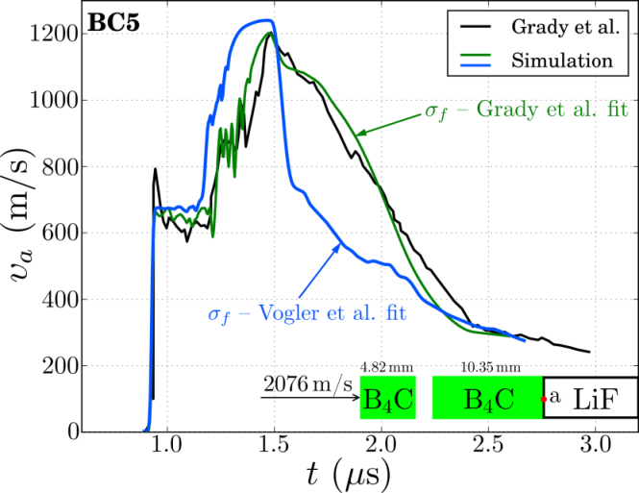
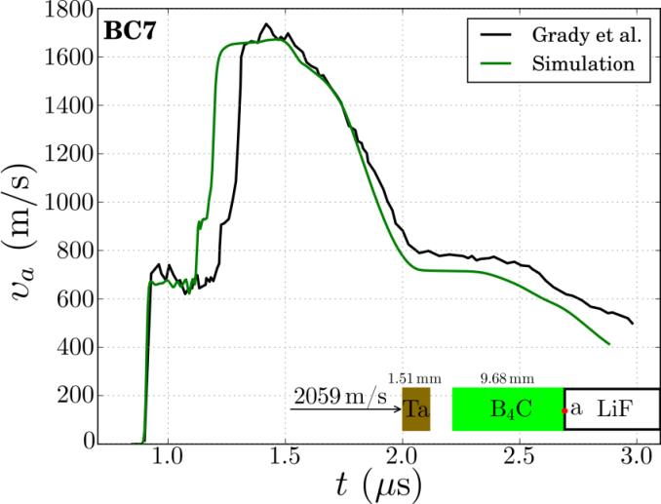
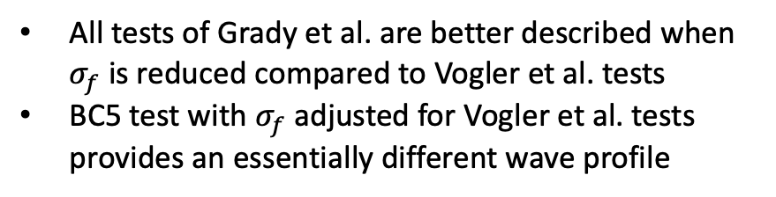
Simulation of Grady et al. tests*
VNIIA
ROSATOM
All tests of Grady et al. are better described when $σ_{f}$ is reduced compared to Vogler et al. tests
BC5 test with $σ_{f}$ adjusted for Vogler et al. tests provides an essentially different wave profile
*D. E. Grady and R. L. Moody, Tech.Rep. SAND96-0551 (1996)
Model: S. A. Dyachkov et al., Journal of Applied Physics 124 085902 (2018)

Slide 15
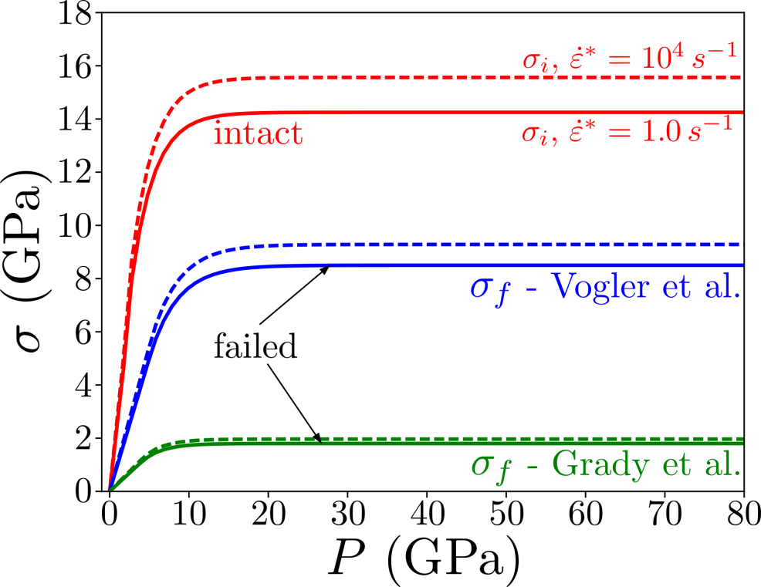
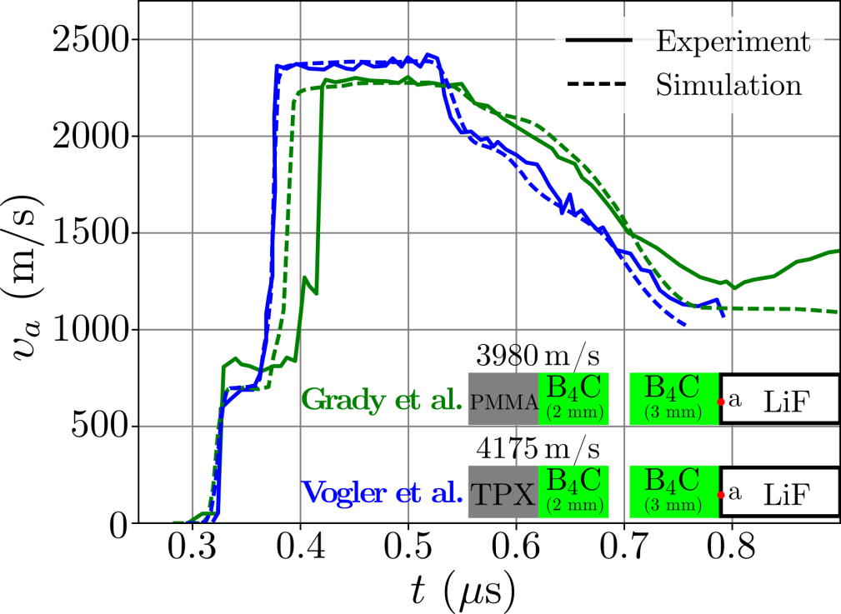
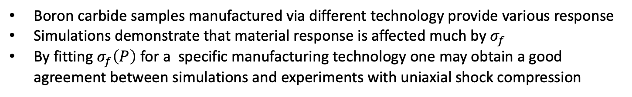
Failed material strength effects
VNIIA
ROSATOM
Strength of B₄C may vary in samples
Wave profiles in two kinds of B₄C samples
Boron carbide samples manufactured via different technology provide various response
Simulations demonstrate that material response is affected much by $σ_{f}$
By fitting $σ_{f}\left(P\right)$ for a specific manufacturing technology one may obtain a good agreement between simulations and experiments with uniaxial shock compression
Vogler T. et al. J. Appl. Phys. 95, 8, 4173–4183 (2004)
D. E. Grady and R. L. Moody, Tech.Rep. SAND96-0551 (1996)
Model: S. A. Dyachkov et al., Journal of Applied Physics 124 085902 (2018)

Slide 16
Aluminum Nitride

Slide 17
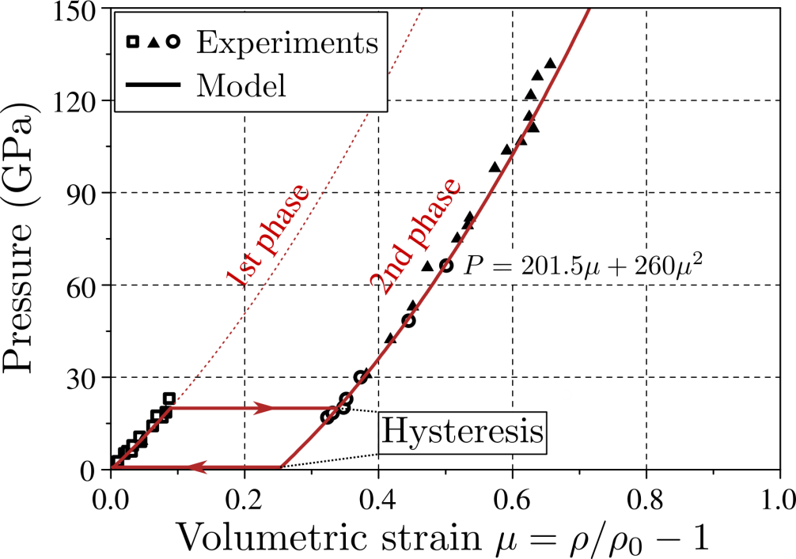
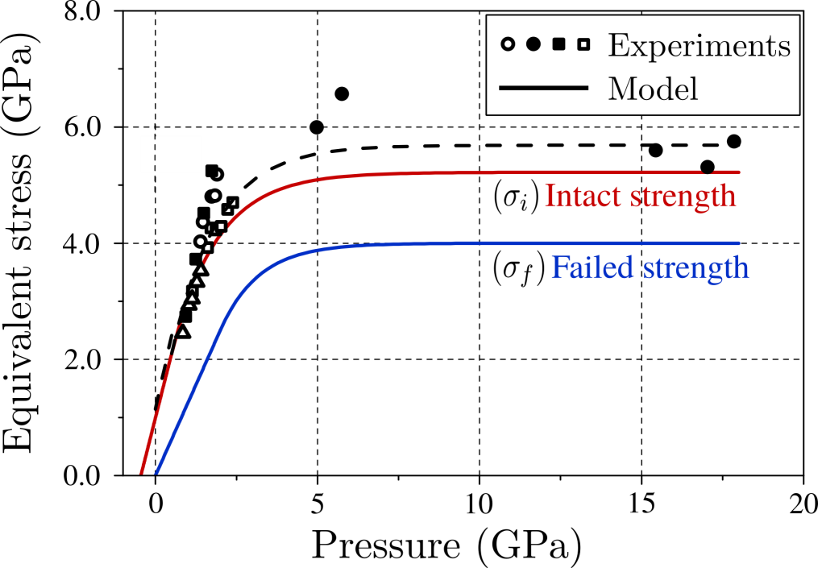
Aluminum nitride (AlN)
VNIIA
ROSATOM
Equation of state
Strength properties
Structural phase transition effect on wave profiles is taken into account
Hysteresis should be included to the model for the proper release profile
G. R. Johnson and T. J. Holmquist, Journal of Applied Physics 94, 1639 (2003)

Slide 18
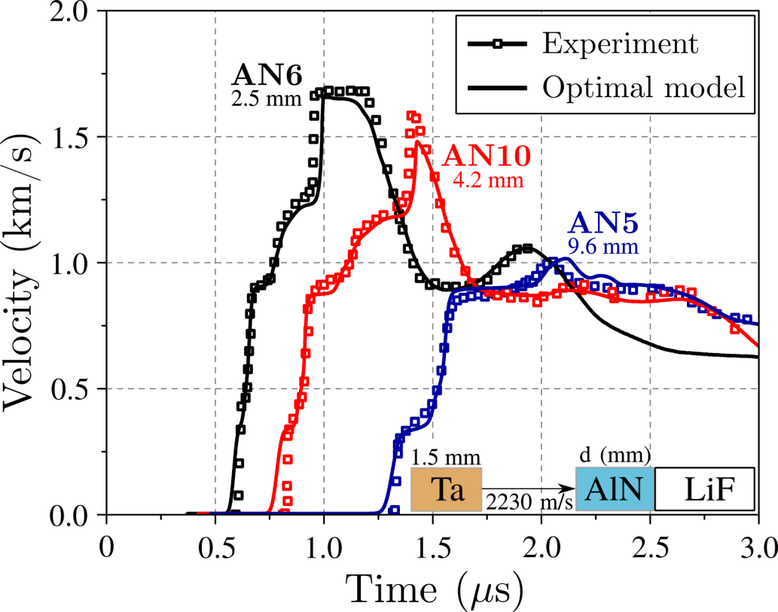
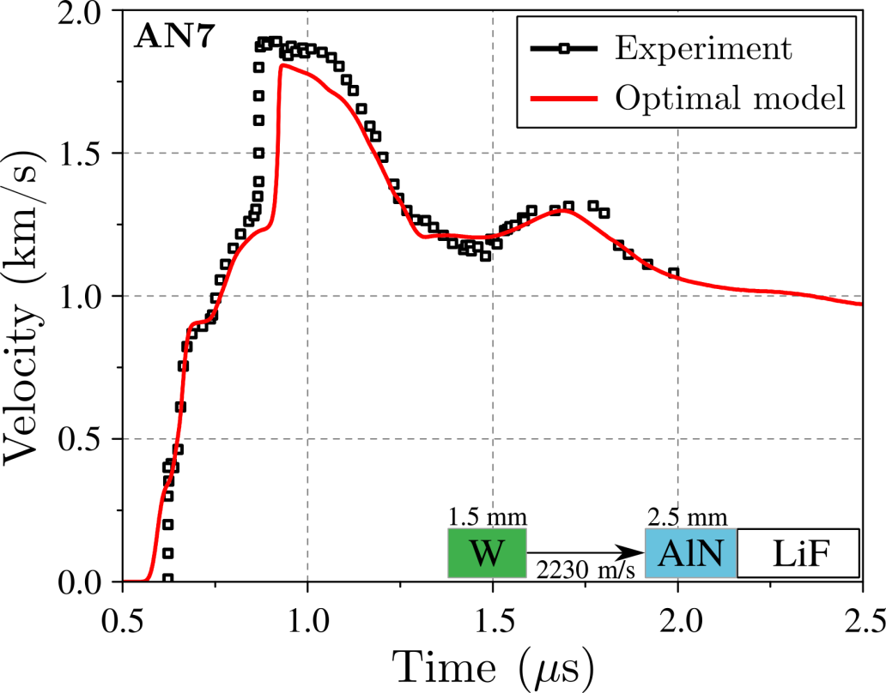
Aluminum nitride (AlN)
VNIIA
ROSATOM
Agreement is achieved for different samples

Slide 19
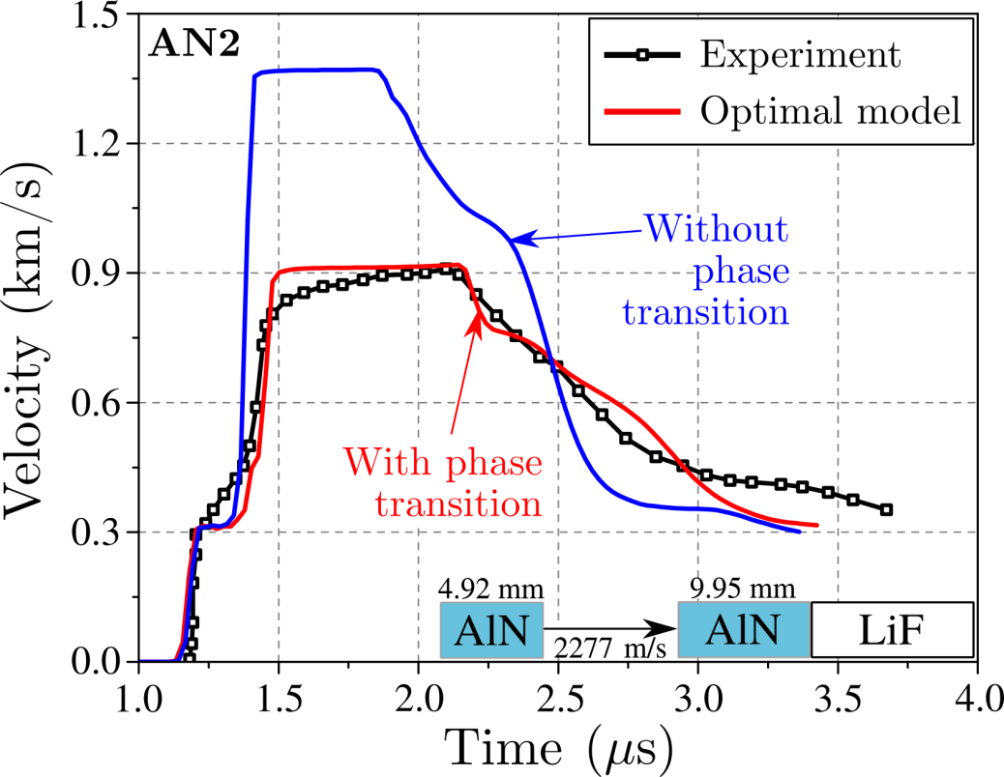
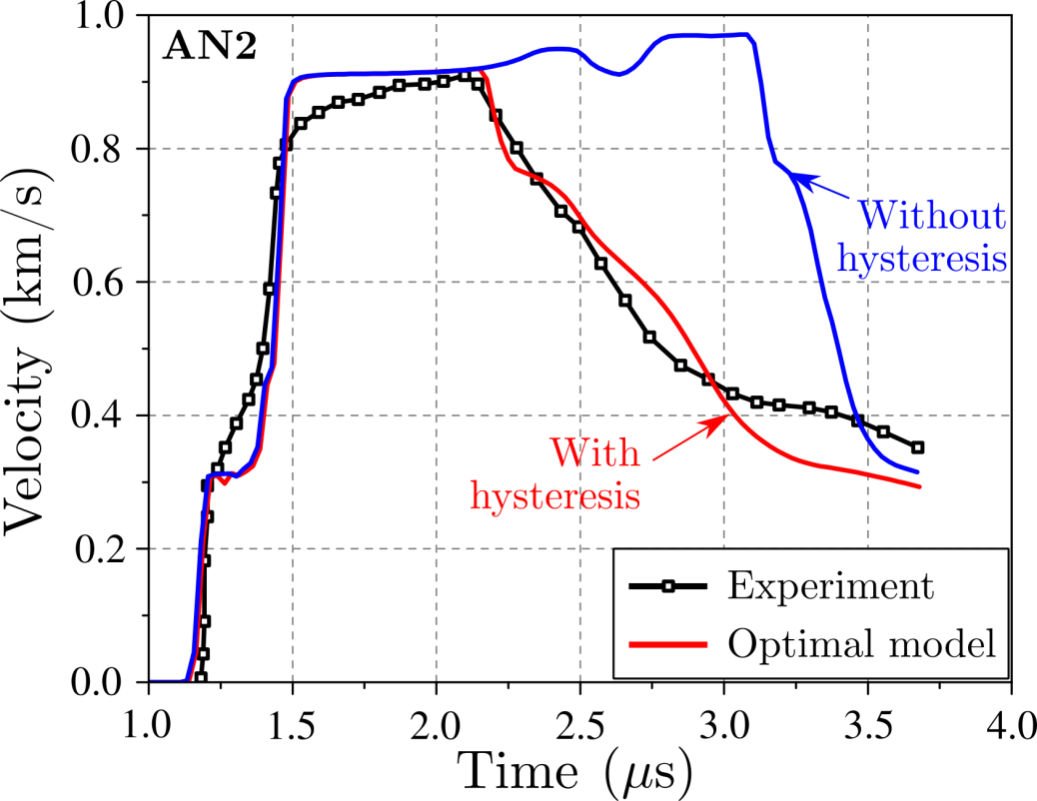
Aluminum nitride (AlN)
VNIIA
ROSATOM
Phase transition effect
Hysteresis effect
Phase transition reduces the wave amplitude providing agreement with experiments
Reverse phase transition should begin at lower amplitude than direct one (hysteresis) which affects the release wave
G. R. Johnson and T. J. Holmquist, Journal of Applied Physics 94, 1639 (2003)

Slide 20
Silicon carbide

Slide 21


Silicon carbide (SiC)
VNIIA
ROSATOM
Phase transition with hysteresis
Strength properties
Second phase should be included to the model, however lack of experiments exist to calibrate reference pressure curve
Hysteresis: 100 GPa for the direct phase transition, 35 GPa for the reverse

Slide 22


Silicon carbide (SiC)
VNIIA
ROSATOM
Release experiment
Reshock experiment
Taking phase transition into account results in a correct shock wave amplitude (plateau)
Both release and reshock (with heavy backer) experiments are reproduced well
R. Feng, G. Raiser, and Y. Gupta, Journal of applied physics 83 , 79 (1998)

Slide 23


Silicon carbide (SiC)
VNIIA
ROSATOM
Release experiments
Reshock experiments
Both release and reshock tests by Vogler et al. (2006) are reproduced well
T. Vogler, W. Reinhart, L. Chhabildas, and D. Dandekar, 99 Journal of applied physics, 023512 (2006)

Slide 24
Conclusion
VNIIA
ROSATOM
B₄C, AlN and SiC models are developed for simulations of intense shock shock loading up to 100 GPa
An explicit numerical algorithm is proposed for shear stress and damage evaluation during shock loading
An optimization algorithm is proposed for model parameters evaluation
Boron carbide samples produced via different manufacturing technology may have different strength after failure
Phase transitions and hysteresis should be included to the model for AlN and SiC simulations
e-mail: sergei.dyachkov@phystech.edu

